Slide 1
Superstore Marketing Analysis
Name: Sandra Joseph

Slide 2
Problem Statement:
Superstore generates large volumes of sales and customer data across multiple regions and product categories. However, without proper analysis, valuable insights into customer behavior, sales trends, and marketing effectiveness remain hidden. This project aims to clean, analyze, and visualize the dataset to identify patterns, segment customers based on recency, and provide actionable recommendations for improving marketing strategies and business performance.

Slide 3
Dataset Overview
Source: Superstore Marketing Dataset (CSV format)
Rows: 2,240 records
Columns: 21 features
Data Type: Mix of numerical and categorical data

Slide 4
Key Columns
Recency-Days since last purchase
Income-Customer annual income
MntWines,MntFruits,MntMeatProducts,etc-Amount spent in product categories
NumWebPurchases,NumStorePurchases-Purchases through different channels
Response-Whether customer responded to the campaign

Slide 5
Data Cleaning
Removed 24 rows with missing values in Income
Standardized text formats: capitalized first letter, changed
Checked for and confirmed no duplicate rows
Created Recency_Segment column:Active: ≤ 30 days, Warm: 31–60 days, Dormant: > 60 days
Exported cleaned files

Slide 6
Recency Segmentation
Definition: Number of days since a customer’s last purchase.
Purpose: Helps group customers by recent activity for targeted marketing.
Segments Created:
Active → Last purchase within 30 days
Warm → Last purchase between 31–60 days
Dormant → No purchase in over 60 days
Insight: Majority of customers fall into the Warm category.

Slide 7
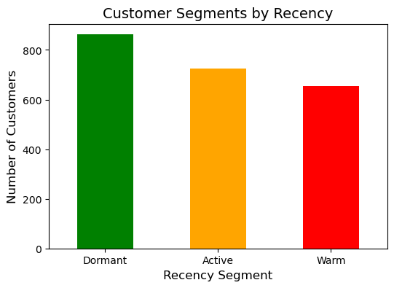
EDA Visualizations
- The Dormant segment has the highest number of customers, approximately 750.- The Active segment has around 650 customers.- The Warm segment has about 600 customers.

Slide 8
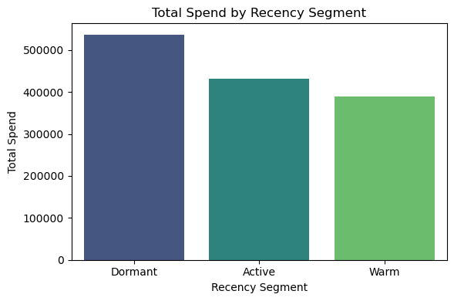
Dormant customers have the highest total spend. Active customers have a significant total spend. Warm customers have a lower total spend.

Slide 9
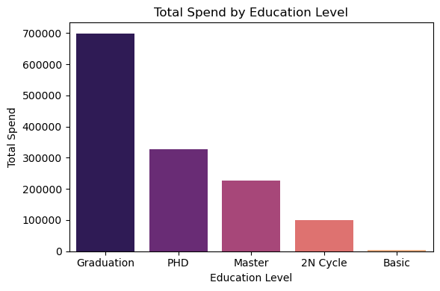
- Highest Total Spend: Customers with a "Graduation" education level have the highest total spend, approximately 600,000.- Decreasing Total Spend: Total spend decreases as education level increases beyond "Graduation."- Lower Total Spend for Higher Education: "PHD" and "Master" education levels have lower total spends compared to "Graduation."- Lowest Total Spend: "2N Cycle" has the lowest total spend among the recorded education levels, around 100,000.- No Spend for Basic Education: No total spend is recorded for customers with a "Basic" education level.

Slide 10
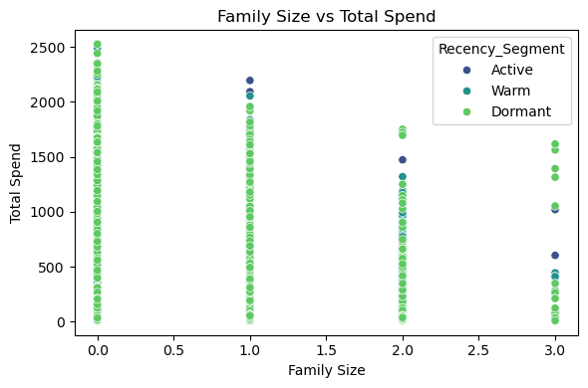
- Family sizes 0, 1, and 3 are the most common. - Highest total spend is observed for family sizes 0 and 1. - Most customers are in the "Warm" recency segment. - Total spend is skewed towards lower values.- Visuals: The scatter plot illustrating the relationship between family size and total spend.

Slide 11
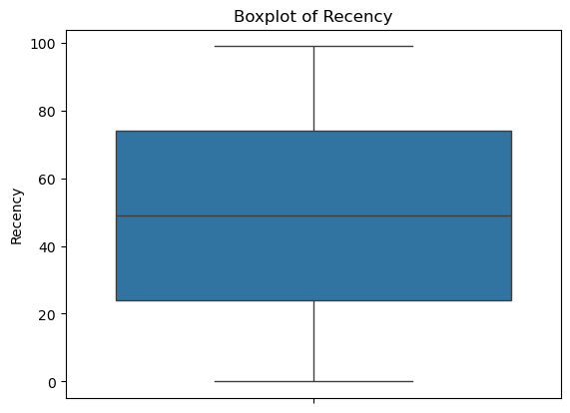
- Median recency value is around 50. - IQR is approximately 20-30. - No outliers visible in the plot. - Recency values are relatively evenly distributed.

Slide 12
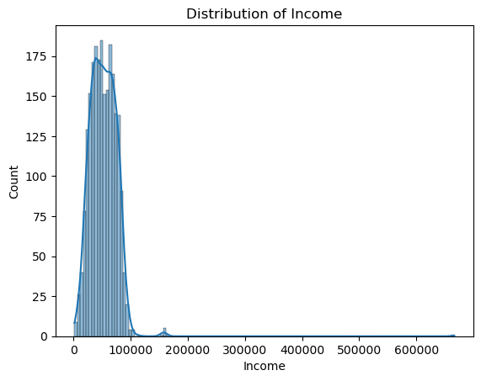
- The distribution of income is positively skewed.- Most individuals have incomes below 100,000.- The majority of individuals have incomes between 50,000 and 75,000.- There are a few outliers with incomes above 200,000.

Slide 13
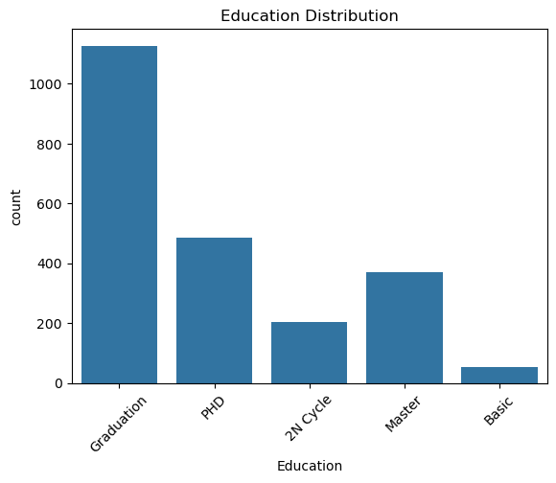
- Majority of the population has a "Graduation" level of education. - Significant presence of "PhD" and "Master" education levels. - Relatively low count for "Basic" education level. - "2nd Cycle" education level has a lower count compared to "Graduation" and "Master."

Slide 14
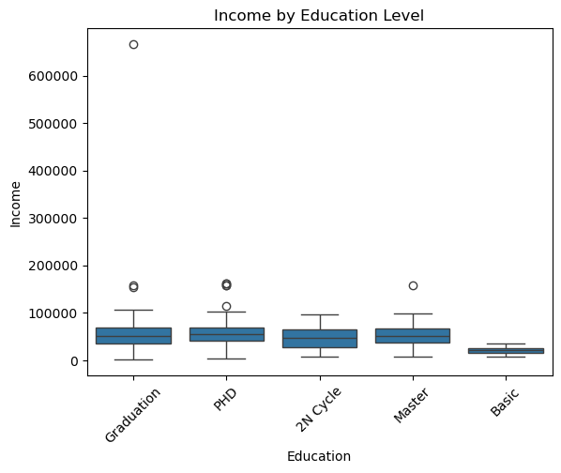
- General increase in income with higher education levels - Fluctuations in income for certain education levels - Highest income associated with Master education level - Lowest income associated with Basic education level

Slide 15
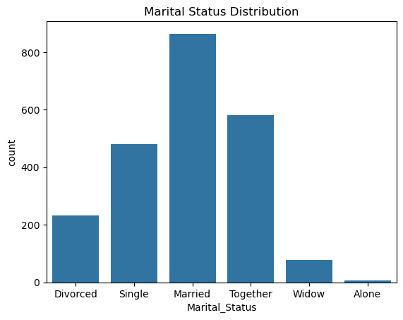
Majority of customers are Married, representing the largest group. Significant portion of customers are Single or Together. Smaller groups include Divorced, Widow, and Alone. Cleaned data by replacing unusual entries ("YOLO" and "Absurd") with Alone

Slide 16
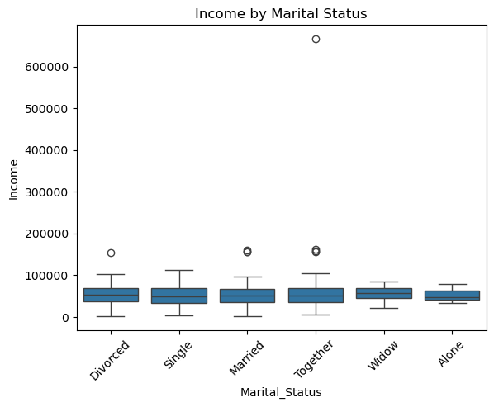
- Median income is relatively consistent across different marital statuses Median income levels for Divorced, Single, Married, Together, Widow, and Alone are relatively close. Outliers exist in the Married and Together groups, indicating a few individuals with exceptionally high income. This suggests income disparities are present but not widespread across marital categories.

Slide 17
Key Insights from the Analysis
Recency Segments Dormant customers have highest spent and most customers. Warm segment has many customers but lowest total spend.
Education Graduation level: most common and highest spending group. Higher education (Master/PhD) → no clear link to higher spending.
Marital Status Married customers are the most numerous. Income is evenly distributed across all statuses with a few high earners.
Family Size Smaller families (0–1) → higher spending. Larger families (2–3) → lower spend.
Recency Distribution Recency values are spread out evenly, no major outliers.

Slide 18
Suggested Actions for Improvement
Re-activate Dormant Customers Send targeted loyalty or win-back offers to high-value dormant users.
Boost Warm Segment Engagement Launch campaigns to convert "Warm" customers into Active. Use reminders, personalized recommendations, and offers.
Focus on Graduate-Level Segment Prioritize campaigns for Graduation-level education group (largest & highest spenders).
Family-Oriented Offers Create personalized campaigns for smaller households (0–1 family size). onsider special bundles or deals for larger families to increase engagement.
Marital Status Personalization Use relationship-based targeting for "Married" and "Together" segments.

Slide 19
Conclusion
From my analysis, I observed clear behavioral differences across customer segments.
I believe focusing on dormant customers, individuals with graduation-level education, and smaller family sizes can yield a higher return on investment.
By tailoring strategies based on recency, education, and family size, I can better enhance customer lifetime value and improve overall campaign performance.

